Slide 1
Project Artemis
the job hunt by a data scientist

Slide 2
The 7 Characteristics of highly paid data scientist (a.k.a The Conclusion)

Slide 3
Problem Solving Skills 17 %
Verbal Communication Skills 14 %
Experience 11 %
Business Process 10 %
Machine Learning 9 %
Contract Based Jobs 8 %
Stakeholder Management 7 %

Slide 4
Crawl The WeB and Clean The Mess
The Job ads for pulled from Indeed.com spanning the search terms, Data Scientist, Data Engineer, Data Analysts and Business Analysts From Sydney, Melbourne, Brisbane, Perth and Adelaide.
There are 1065 rows out of which only 335 had any information about salary.
A combination of regular expression and mathematical logic is used to clean the obtained dataset. The Daily, Hourly, and Weekly rates are converted into yearly rates. We consider 50 Weeks a year, 250 days an year (50 x 5) and 2000 Hours an year (250 X 8).

Slide 5
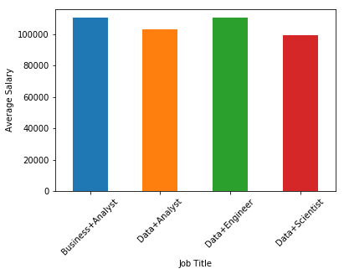
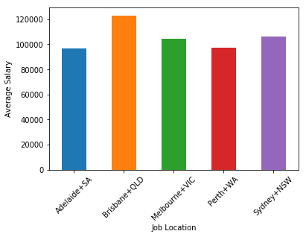
Initial Information

Slide 6
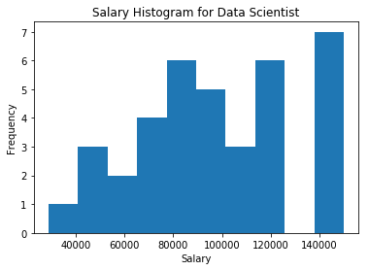
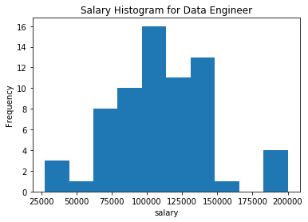
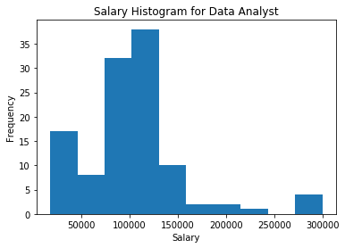
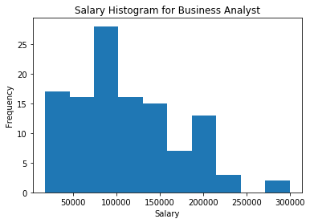

Slide 7
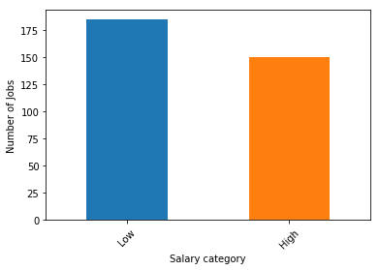
The Classification Models
Base Line = 55%

Slide 8
Feature Selection and Hyperparameter Tuning
Use Random Forest Classifier – Use Different N Grams
Find the similar meaning and sounding words or unmeaningful words.
Remove them from corpus using the stop list.
newstopwords = ['terms','conditions','work','qualification','staff','us','date','time','year’, 'role','skill','support','ability','click','apply','please','contact’, 'applicant','application','close','position','description','button’, 'job','today','send','post','australian','rights','opportunity','process’, 'client','system','include','provide','cover','letter','candidate','need', 'midnight','day','data','daylight','skill','south','sydney','western','analyst']

Slide 9
Lets Classify
Method | Accuracy | Standard Deviation
Logistic Regression (1500 Features) | 0.81 | 0.06
Random Forest (10 Features) | 0.85 | 0.08
Bernoulli Naïve Bayes (4000) | 0.85 | 0.09
KNN (neighbors = 100) | 0.88 | 0.03
SVM (Degree =100) | 0.89 | 0.01

Slide 10
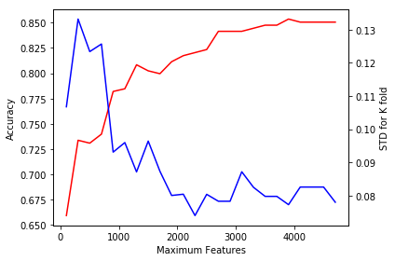
Bernoulli Naïve bayes

Slide 11
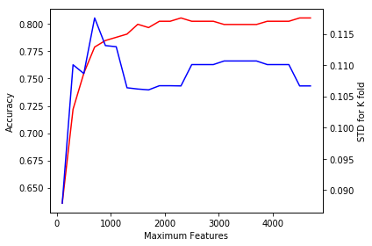
Logistic Regression

Slide 12
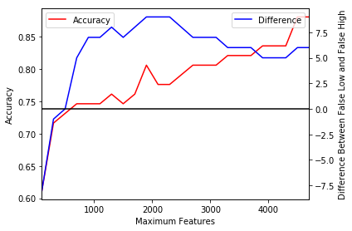
Effect of Changing Features
However, it is better to choose a high accuracy model, predict probabilities and then choose a proper threshold for changing the classification ratios.

Slide 13
Predict the Job Title – Confusion Matrix
Business | Business Analyst | Data Analyst | Data Engineer | Data Scientist
Business Analyst | 105 | 10 | 1 | 1
Data Analyst | 9 | 99 | 1 | 5
Data Engineer | 6 | 8 | 52 | 1
Data Scientist | 1 | 1 | 1 | 34
Baseline: 0.35
Naïve Bayes : 0.61 (Naïve Bayes)
Accuracy Score: 0.86 (Random Forest)

Slide 14
What you WANT Determines Who you Want
Python, SQL, regression, classification, machine learning, modelling – Data Scientist
Model, hadoop, spark, cloud – Data Engineer
Finance, tabase, SQL, Business – Data Analyst

Slide 15
ThAnk You !

